Slide 1


Solar Folder
Team Zero
Michael Goldstein, Madeline Holda, Bill Huang,
Sangjin Lee, Vishva Patel, Olivia Plumb
April 25, 2022

Slide 2
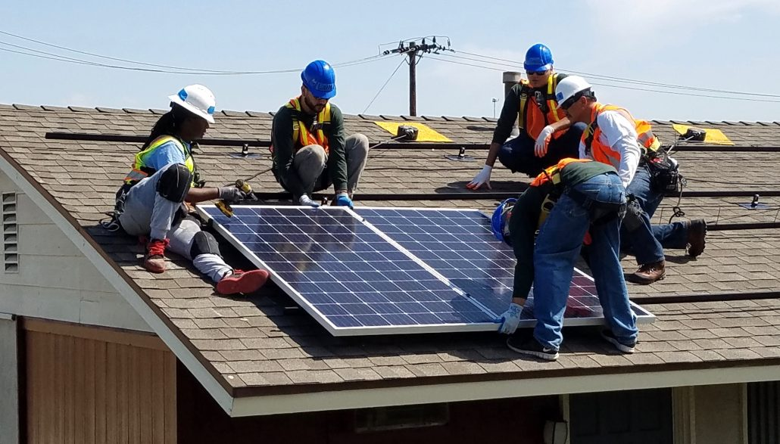
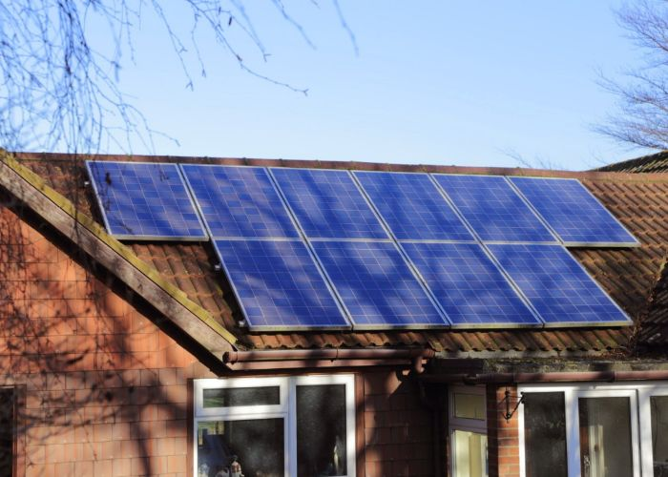
Project Background
Major problems with current solar panel systems:
High upfront costs (typically $20,000-$30,000)
Difficulty of installation
Many homes unsuitable for solar

Slide 3
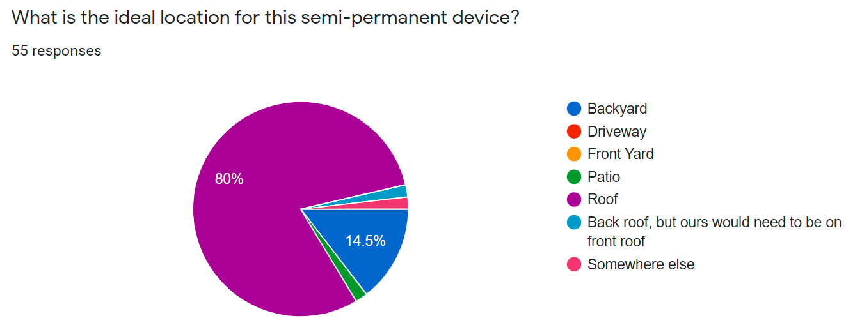
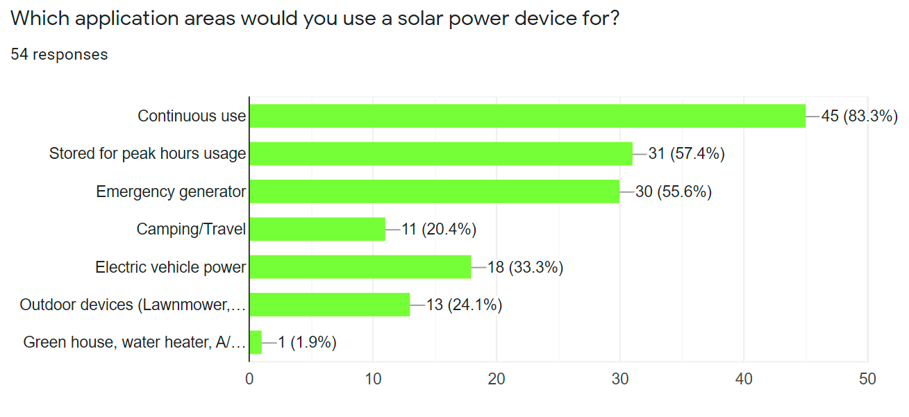
Project Goal
Affordable
Easy to install
Multipurpose
continuous use, storage, backup power generation, charging station
Introduces new customers to clean energy

Slide 4
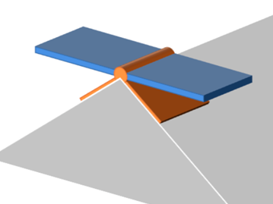
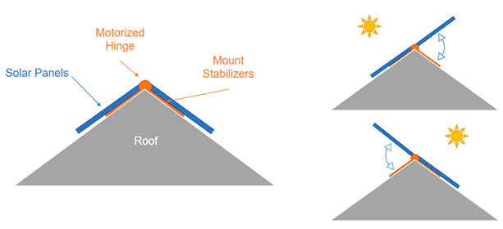

Solution Concept
2 Panel Folding Design
Motorized hinge allows sun tracking
Expandable system
DIY installation (no screws or nails)
Roof and ground configurations
Compatible with most solar panels
Low Cost
Addresses gap in market

Slide 5
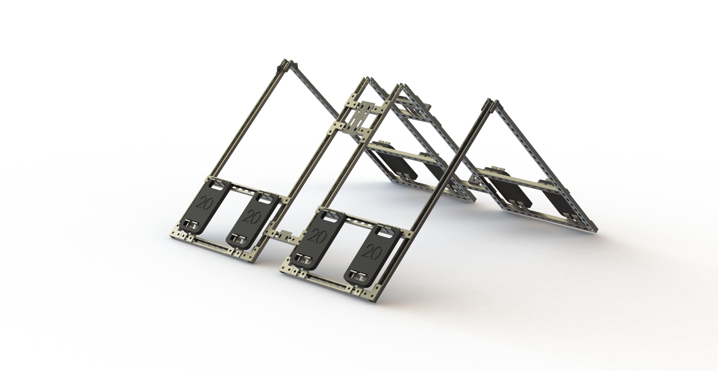
Mount System
Connecting Struts
Individual Mount Block
Individual Mount Blocks
Material: Galvanized Steel
Weight of block: 6.5 kg
Dimension of block: 4 ft x 2.25 ft
Assembly
4 individual mount blocks + connecting strut pieces
Adjusts to all roof angles
Ground or roof mounting
Additional weights for various average wind and roof angles
Can sustain 80 mph winds with deployed panels
Additional Weights

Slide 6
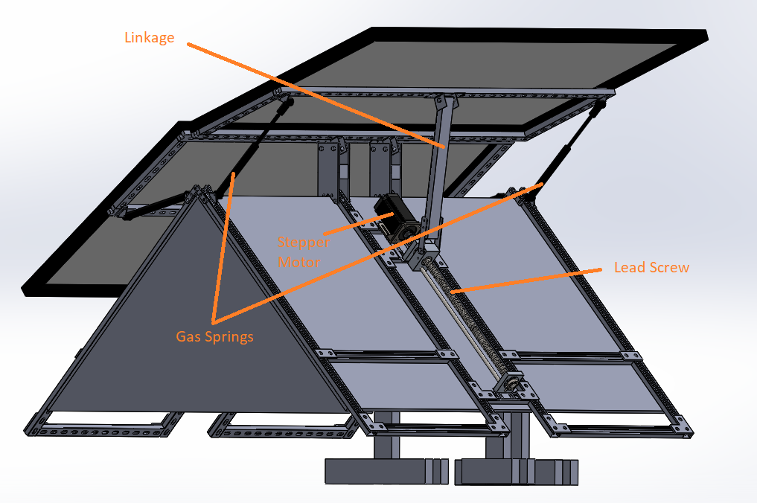
Actuation System
Single Linkage Lead Screw
- Lifts panel under 80MPH wind speed
- Self locking
Gas Springs
- Damping
- Panel weight offset
Direct Drive Stepper Motor

Slide 7
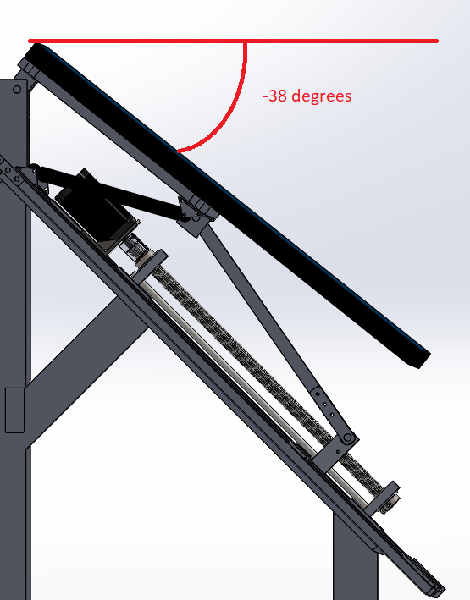
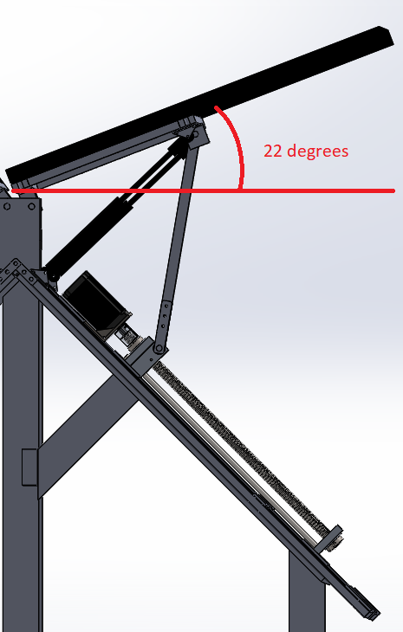
Actuation Range
Lowest Position
Highest Position
Positions anywhere between 22 degrees to -38 degrees throughout the day

Slide 8
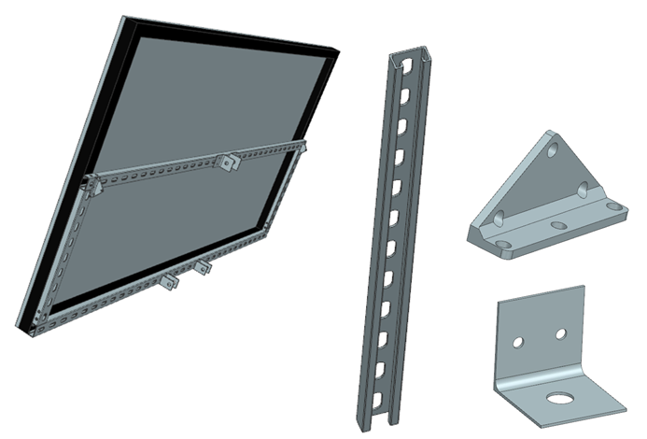
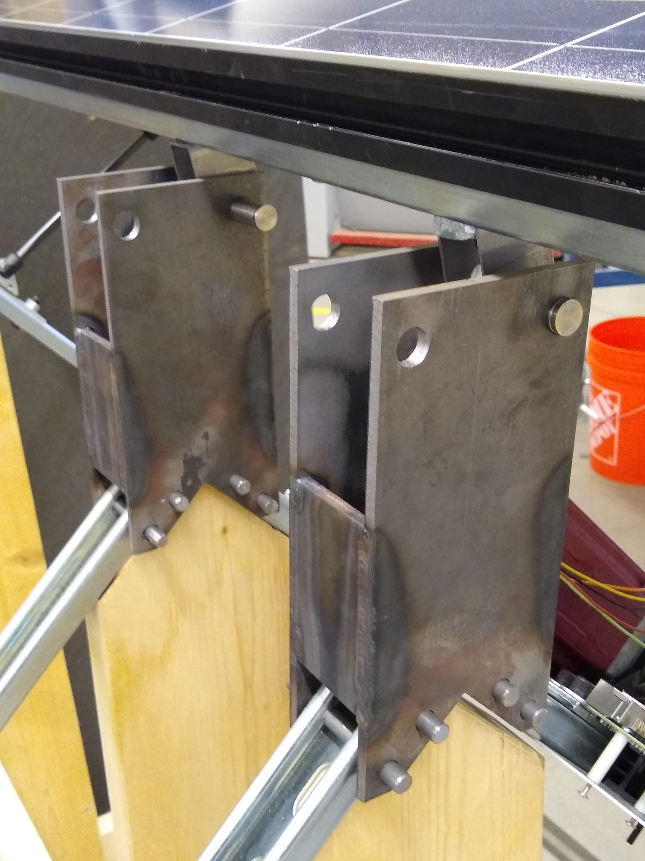
Hinge and Panel Design
Designed to withstand heavy loads
Allows various roof angles
Quick install
Waterjetted and welded
Panel Struts
Hinges

Slide 9
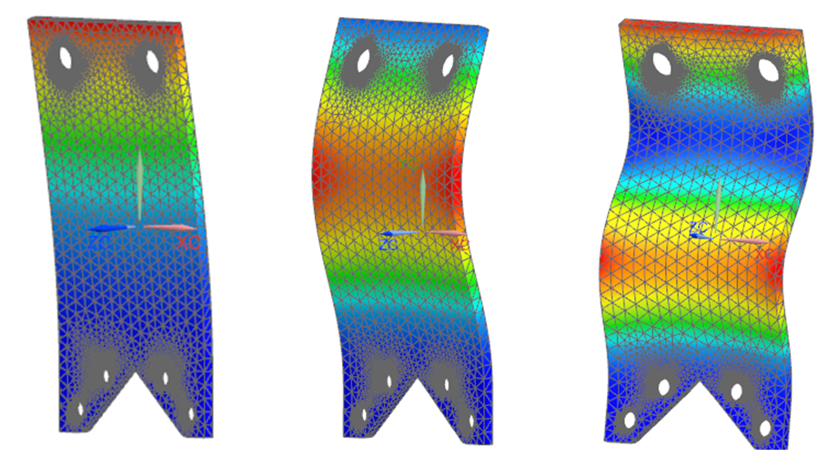
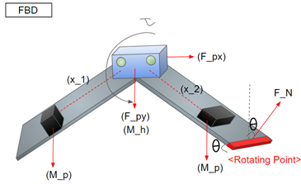

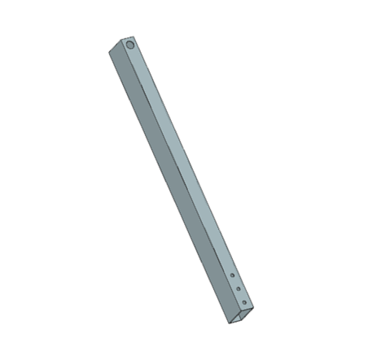
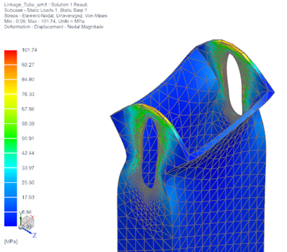
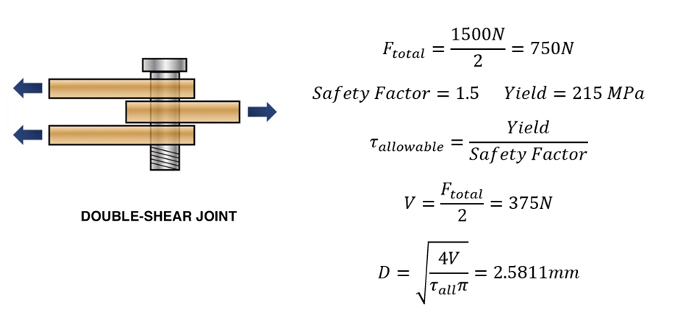
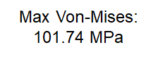
Design Calculations and Verifications
Hinge Buckling Modes

Slide 10
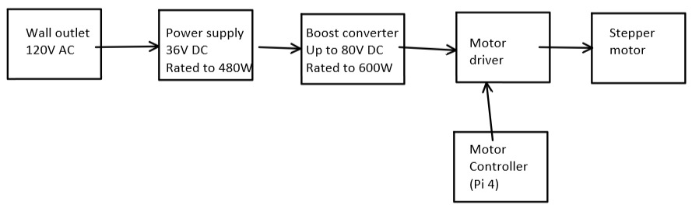
Electrical System Wiring
Power supply transforms 120V wall outlet to ~36V DC for motor
Motor driver determines speed and direction of motor
Raspberry pi acts as motor controller, sending commands to driver
Stepper motor actuates solar panel up and down

Slide 11
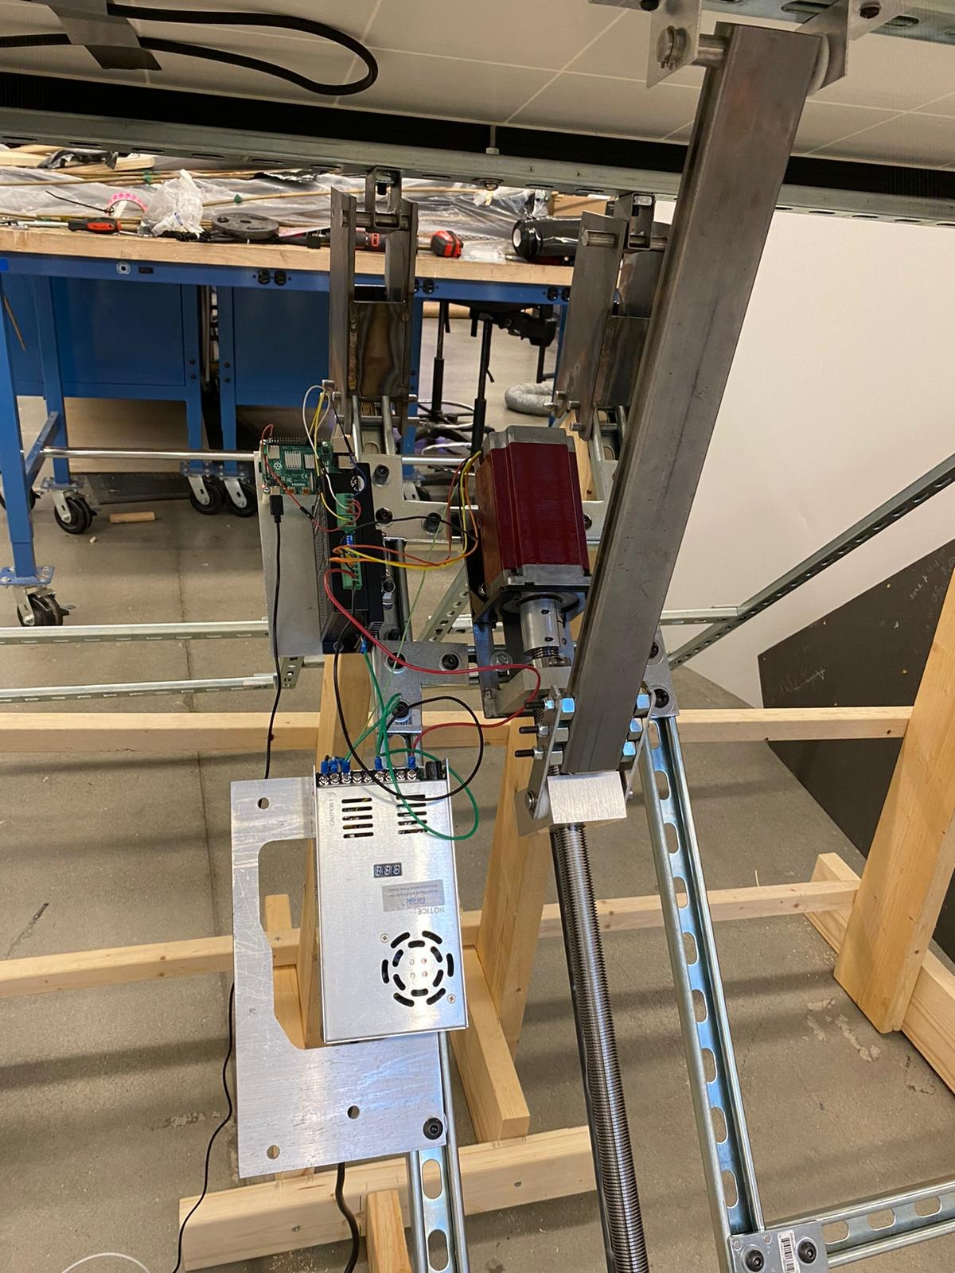
Motor Controller Code
Can control motor motion, including speed and direction
Single-axis tracking
Algorithm options
Pre-determined movement, based on known solar movement patterns
Dynamic tracking, based on sensor feedback
Tracking increases energy capture by an average of 22.5% in Atlanta
Higher in areas with more direct sunlight, and less diffuse sunlight

Slide 12
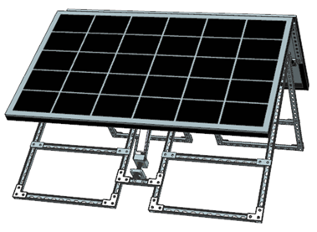
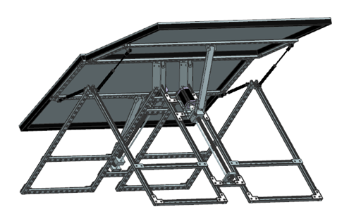
Completed Design

Slide 13
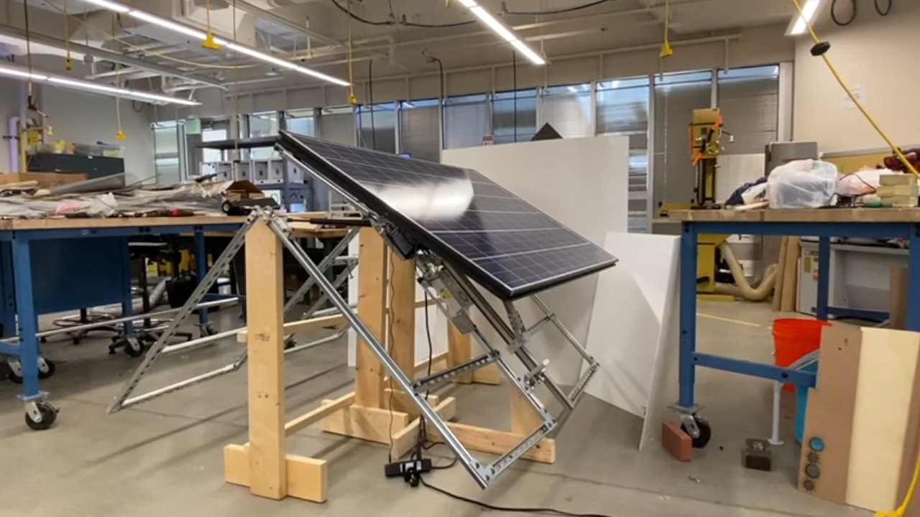
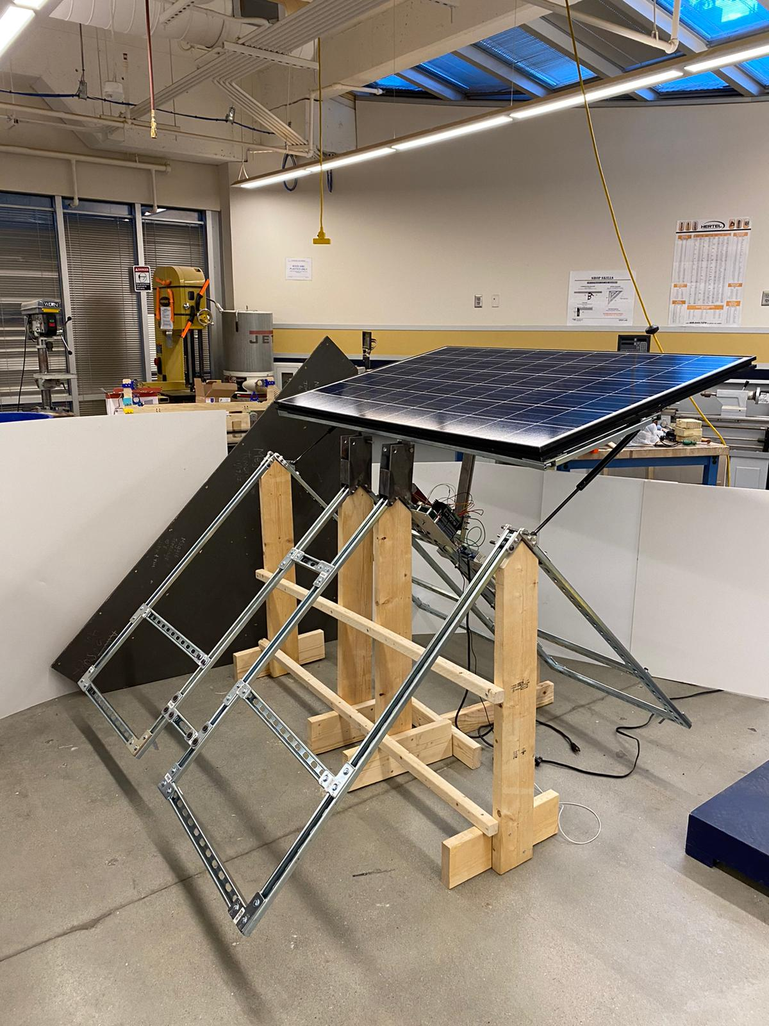
Final Assembly

Slide 14
Thank you for watching!

